Slide 1
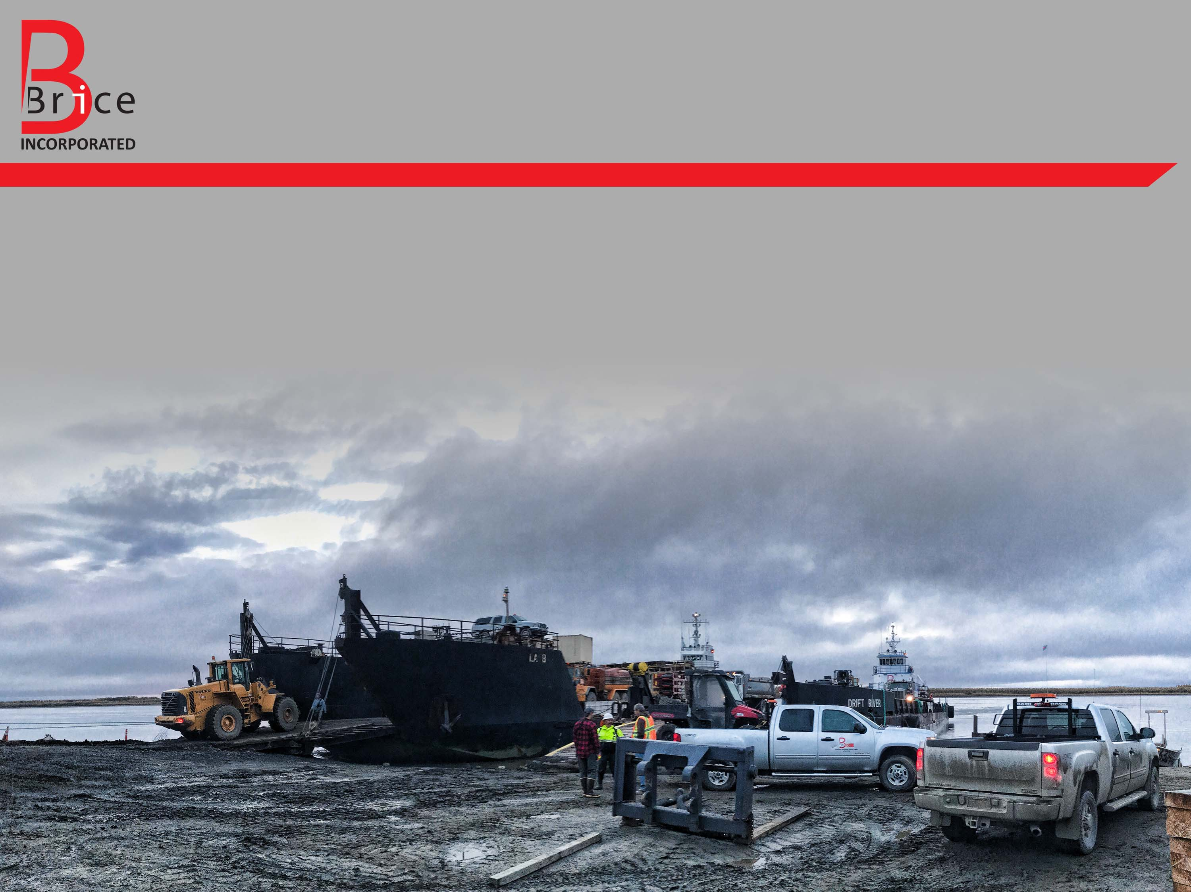
Lessons Learned In Arctic Construction
A Contractor’s Perspective
Presenter: Marcus Trivette, P.E., Construction Manager at Brice Incorporated
Todays Topics for Lessons Learned
Geotechnical
Logistical
Specification

Slide 2
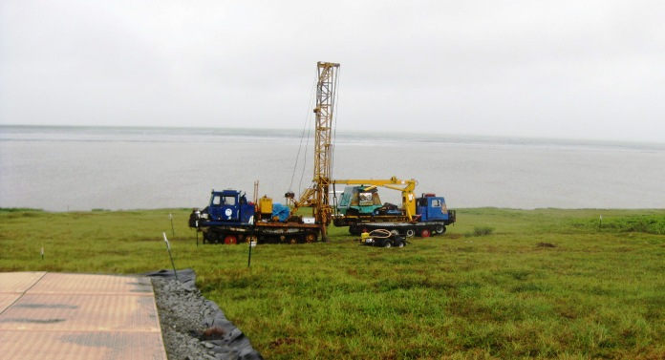
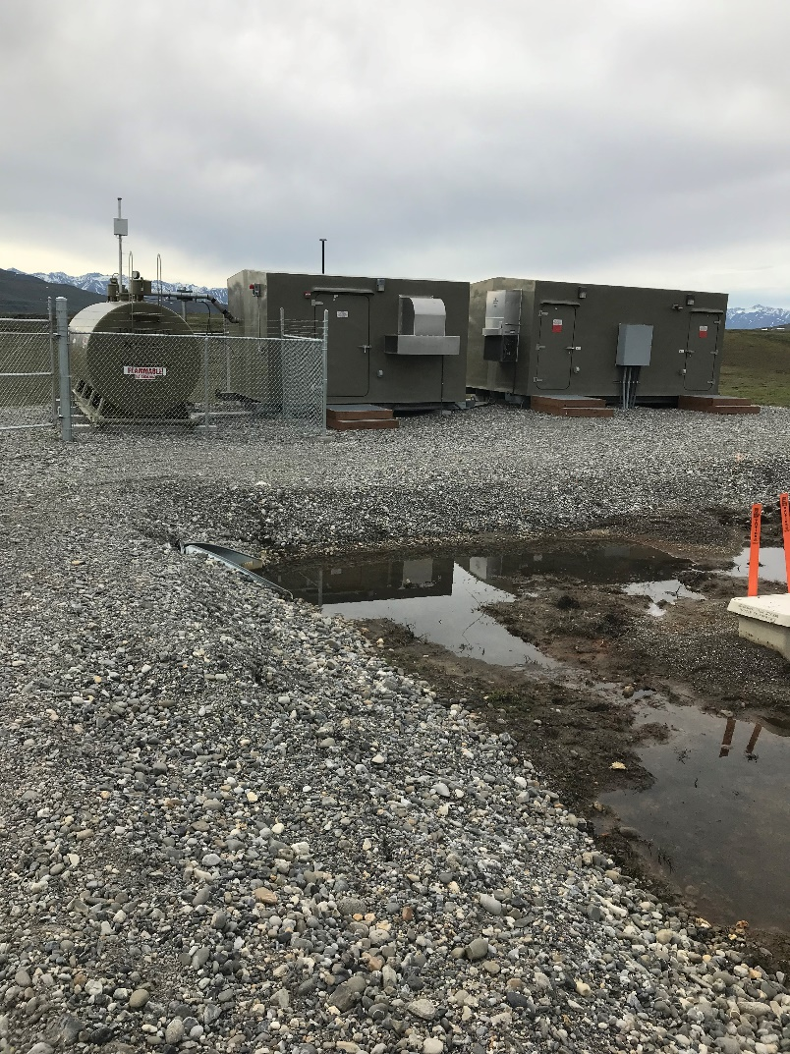
Geotechnical Lesson 1: Investigation
Thorough Geotechnical Investigation is the cheapest insurance you can buy
  “Design assumes no permafrost beneath pad and competent soils.”

Slide 3
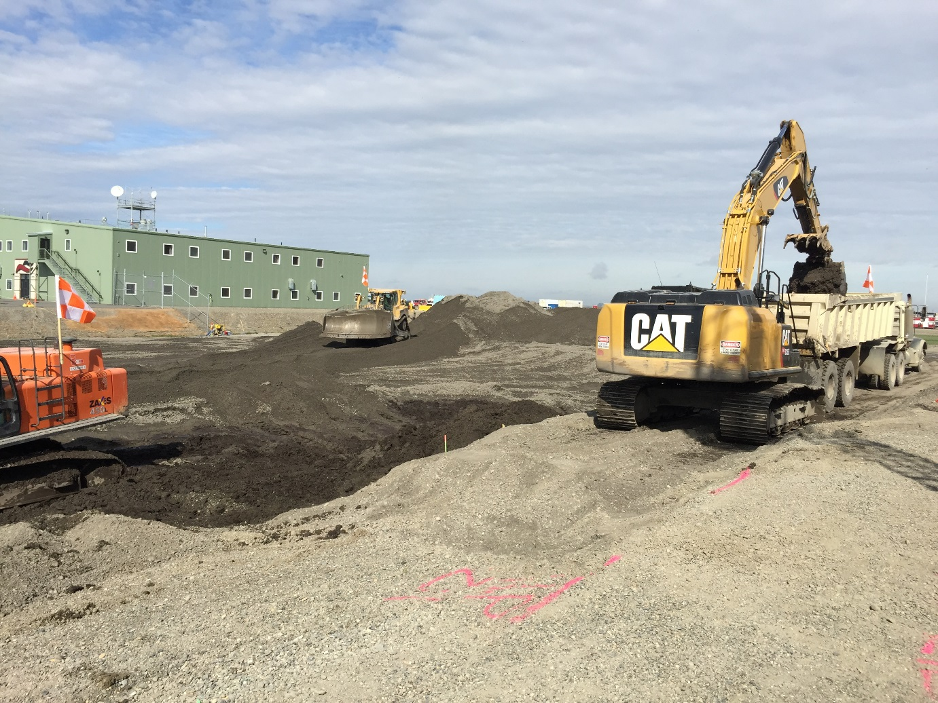
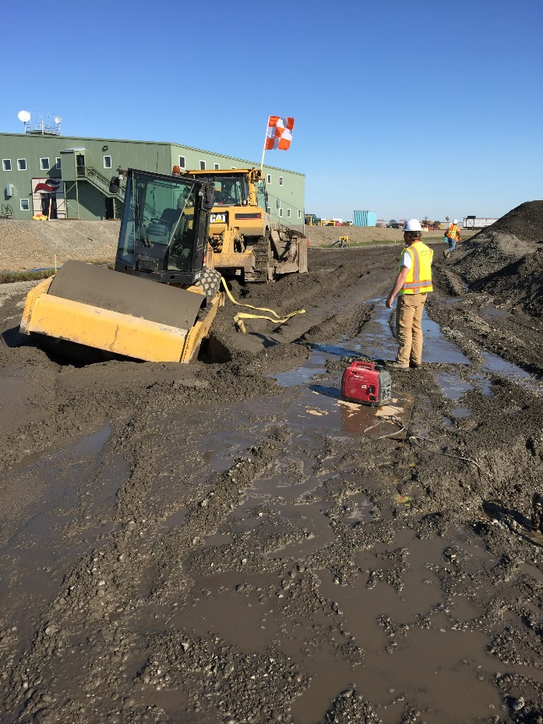
Geotechnical Lesson 2: Timing of Backfill
Ready, set, go!
Moisture control
Thawing subgrade

Slide 4
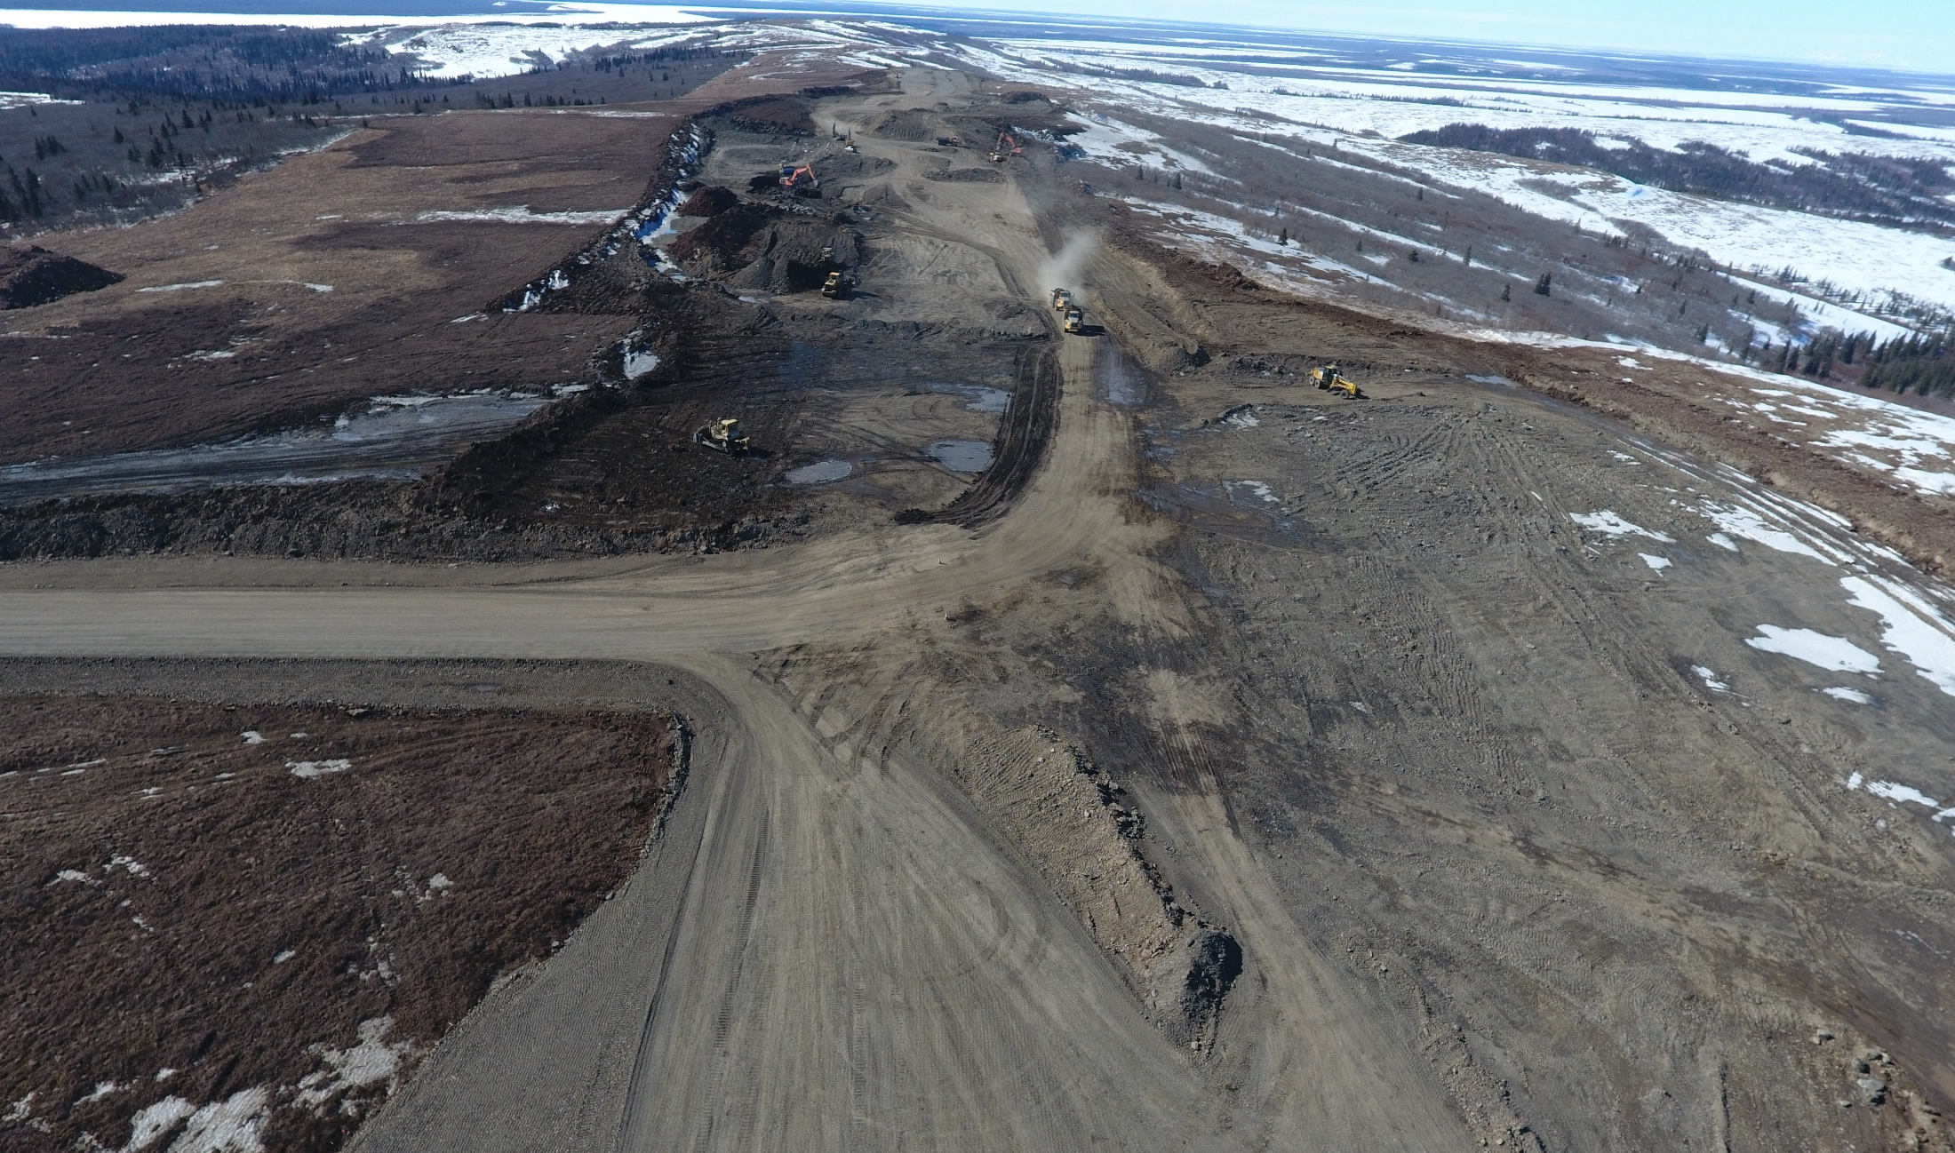
Geotechnical Lesson 3: Fill and Seasonal Thaw
If It’s Frozen… Keep it frozen
Recognize quantity impacts
Does design address long term thaw?

Slide 5
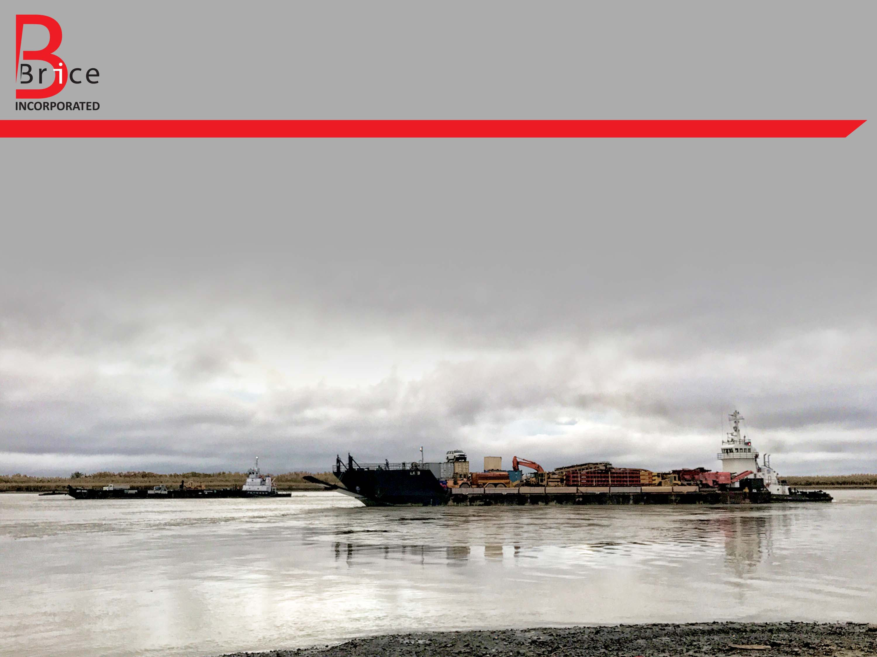
Logistical Lesson 1: Seasonal Access Limitations
Water is the highway to the job
Material site access considerations
Season of construction requirements

Slide 6
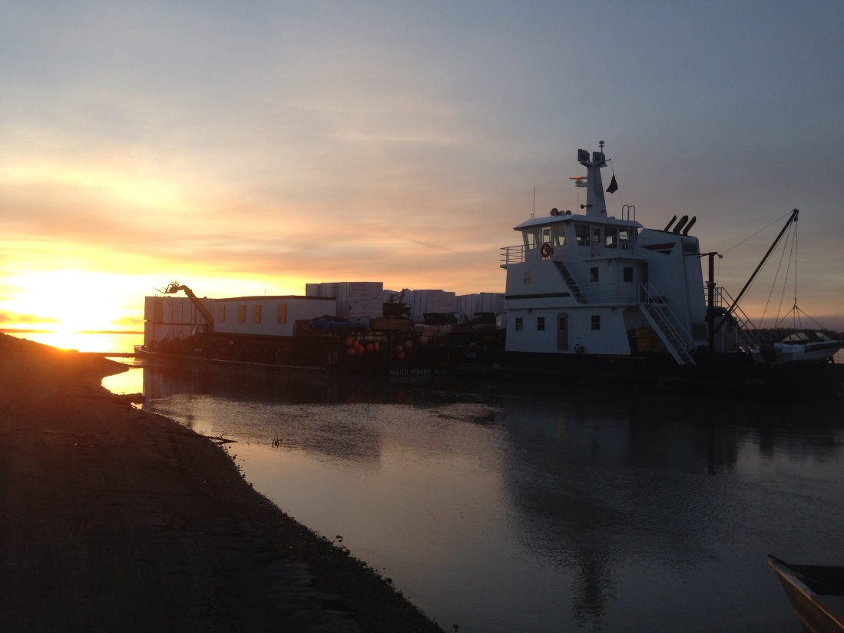
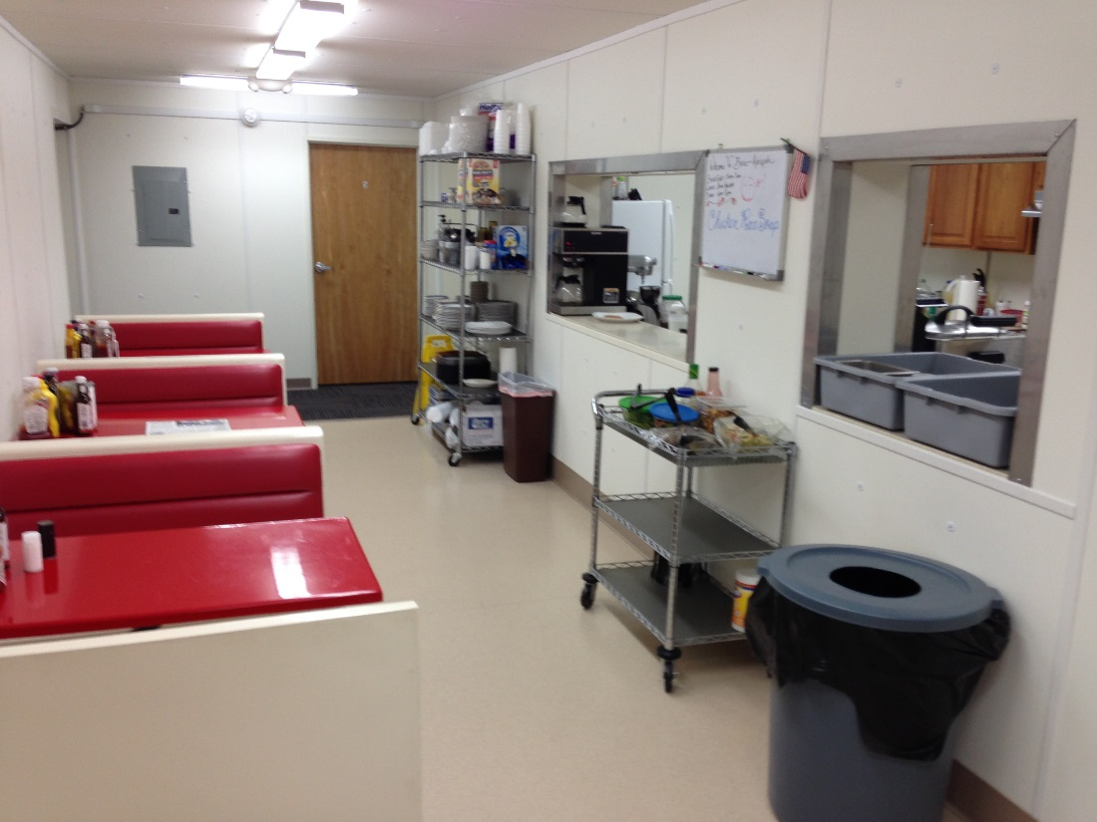
Logistical Lesson 2: Remote Camps
Local hire limitations
Space for setup, parking, storage
Utility requirements while in operation: power (single or three phase), water, sewer, refuse, communications

Slide 7
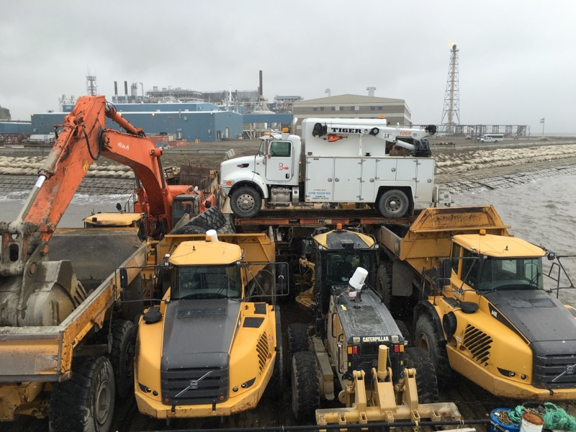
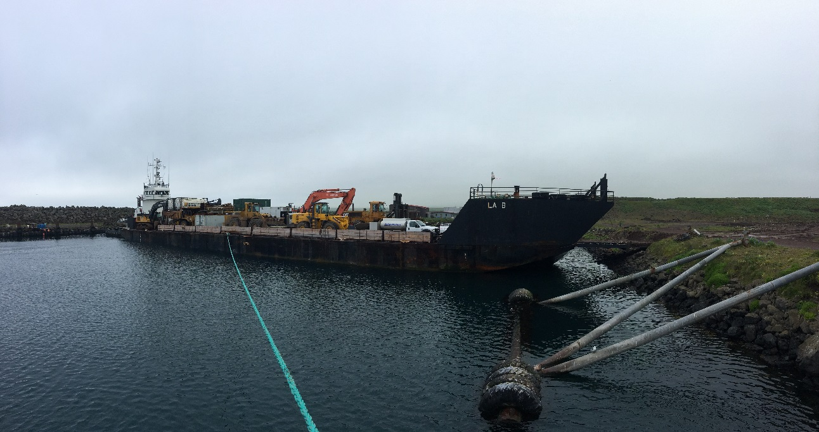
Logistical Lesson 3: Site Access and Barging
Someone can usually get there
What is the right tool for the job?
Timing can dictate most economical option

Slide 8
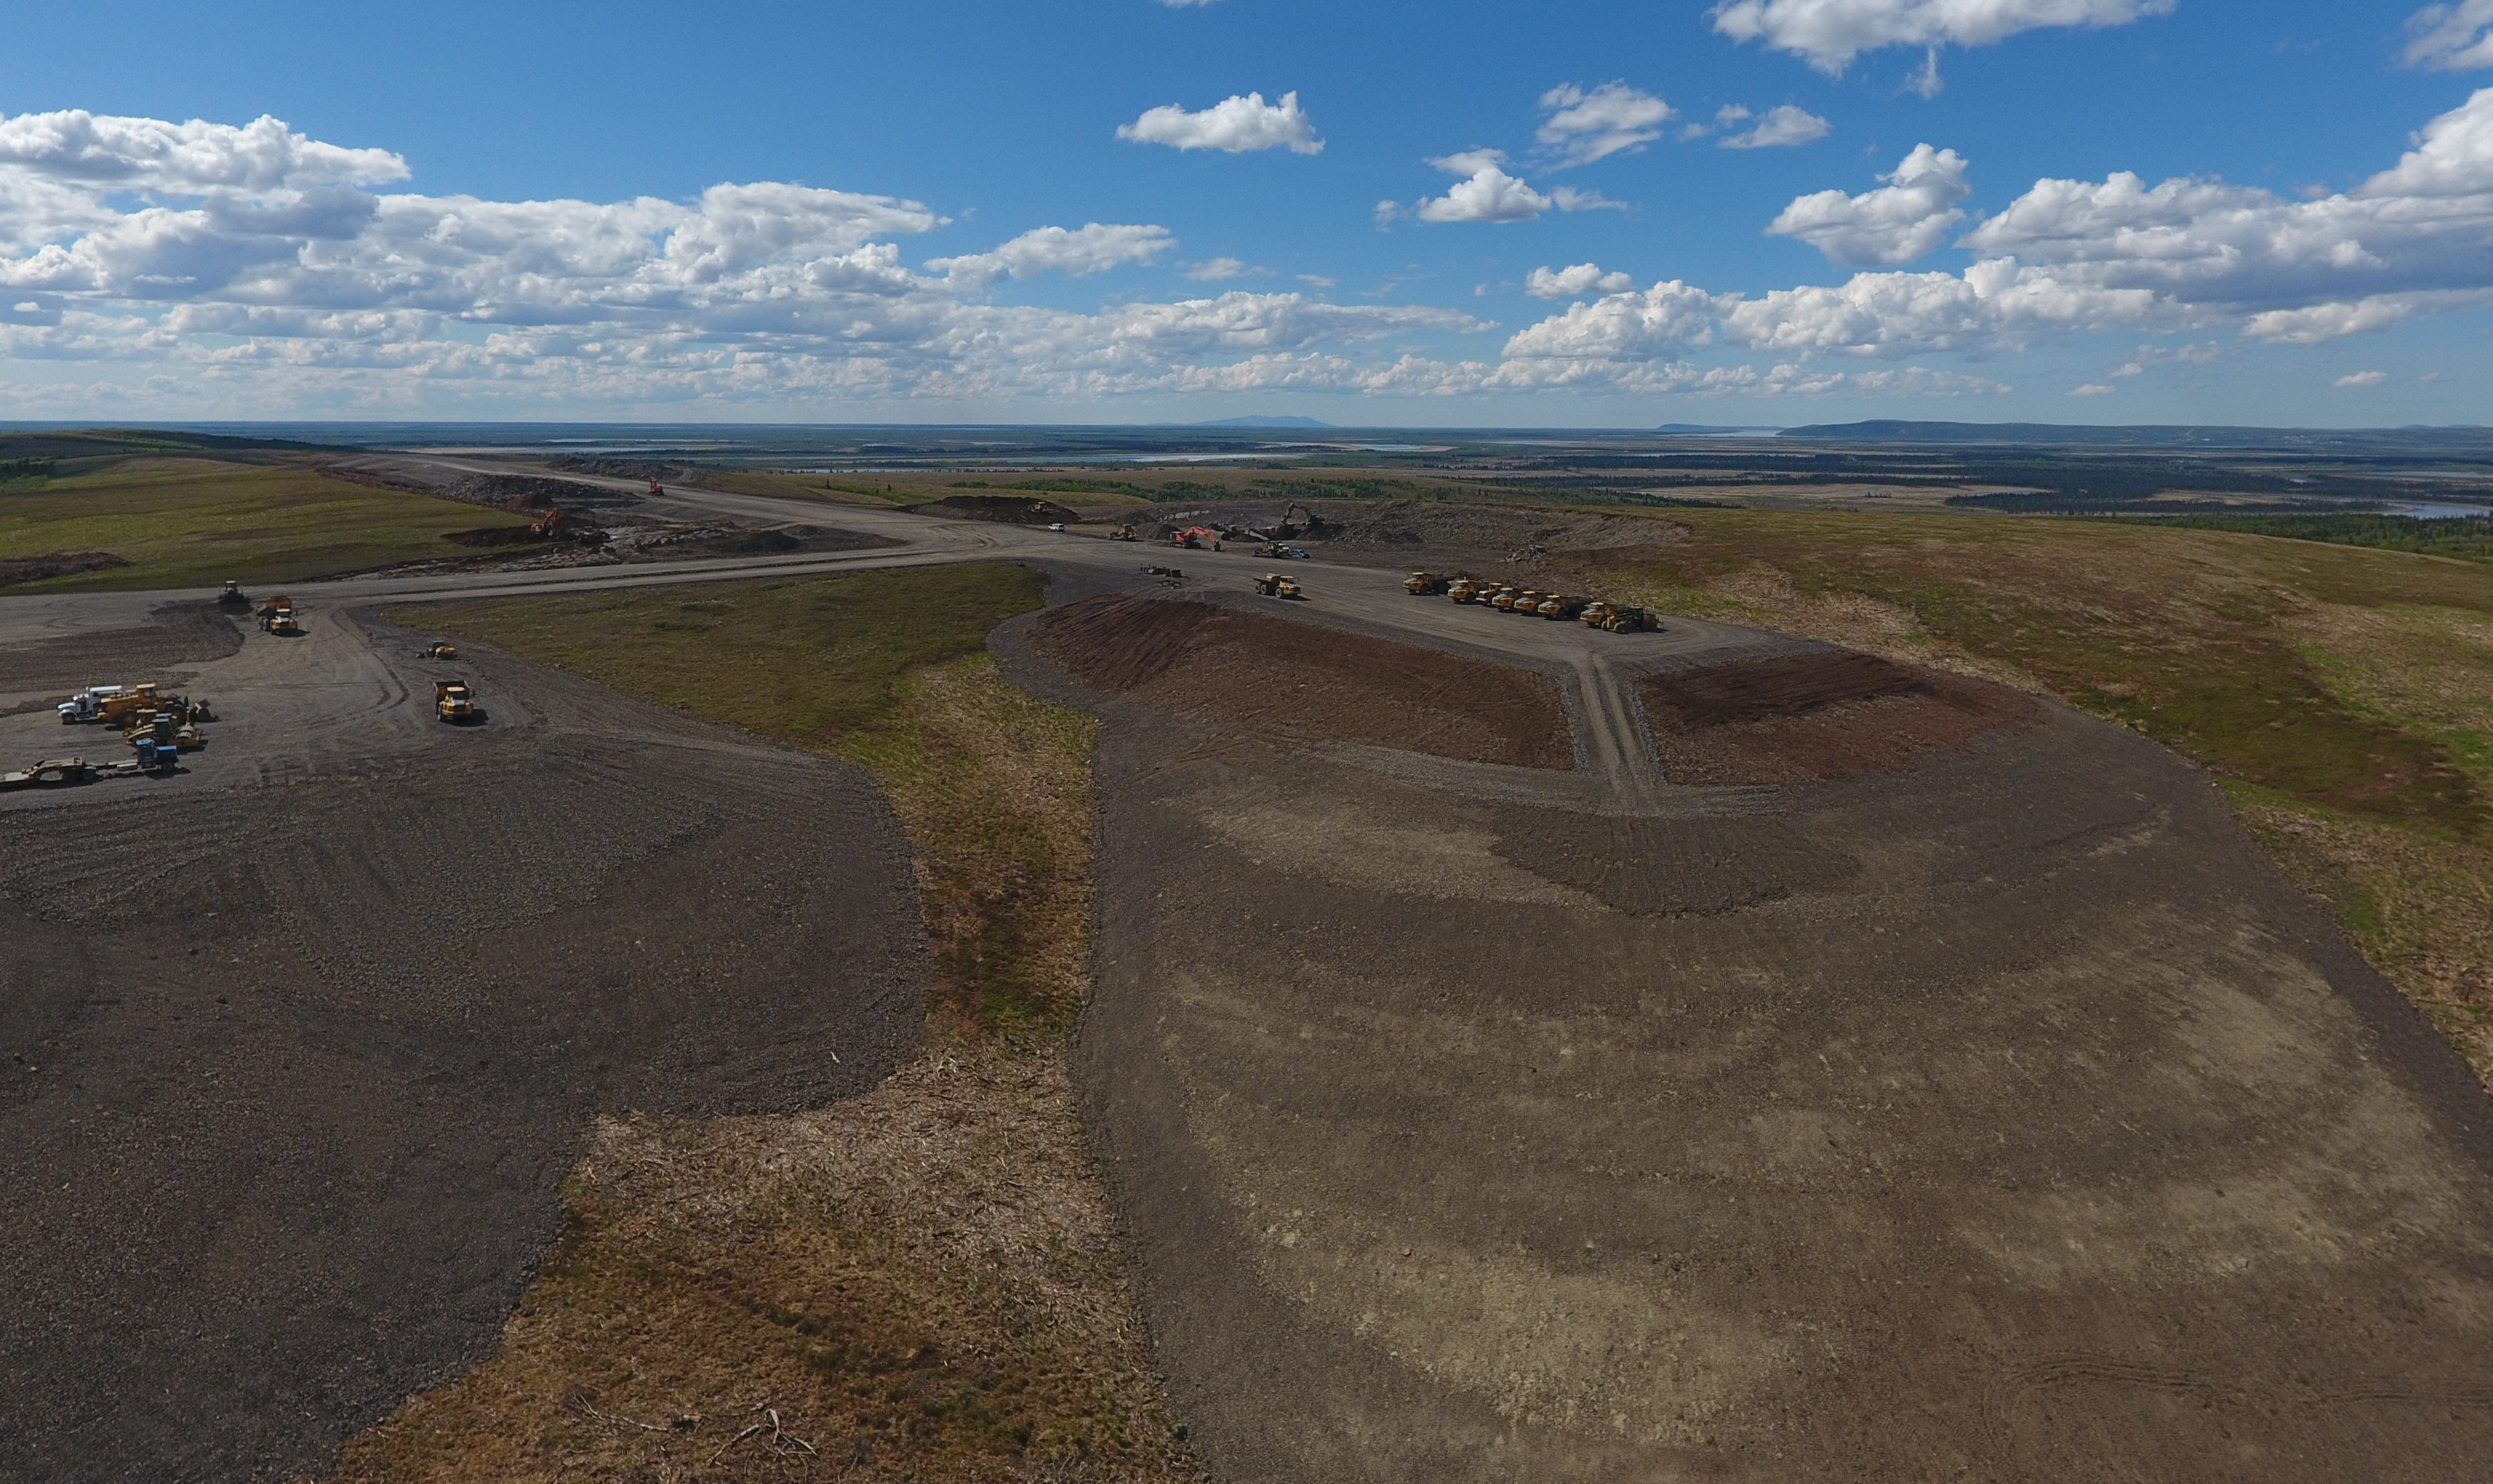
Specification Lesson 1: Aggregate Selection
Align specification with Geotechnical Report
Consideration to Engineer’s Estimate and funding
Funding agency concurrence

Slide 9
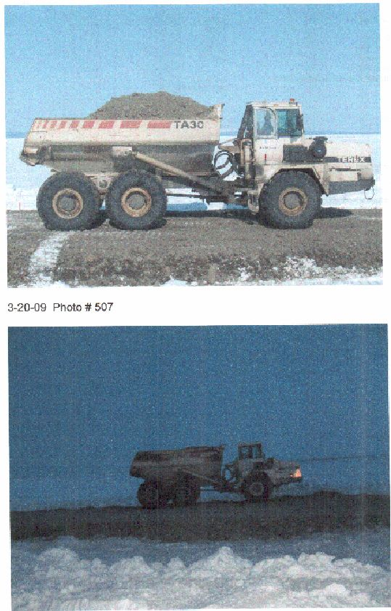
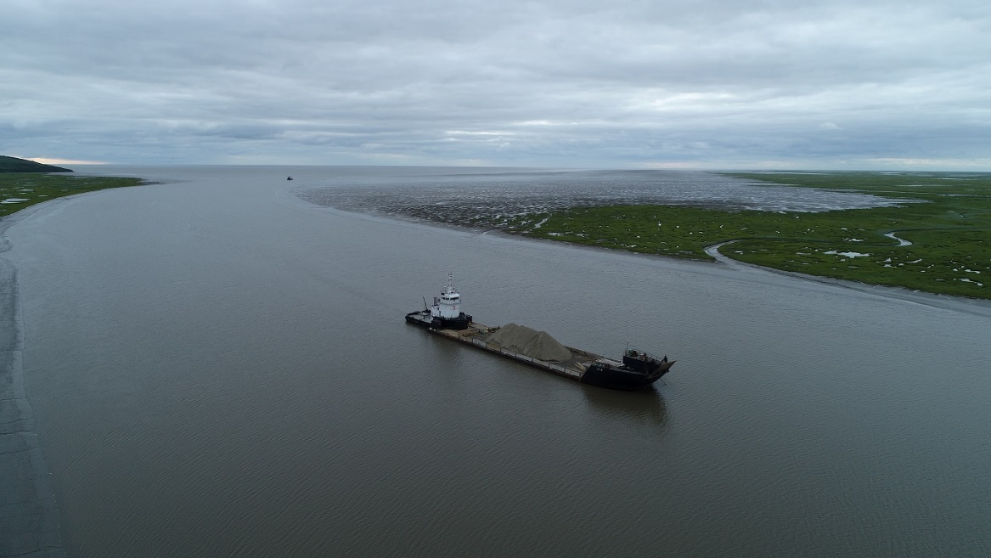
Specification Lesson 2: Volume Measurement
Cubic Yard
Scaled Ton
Barge Displacement
CYVM
Who has the risk? Pitfalls?
What is fair? What is practical?

Slide 10
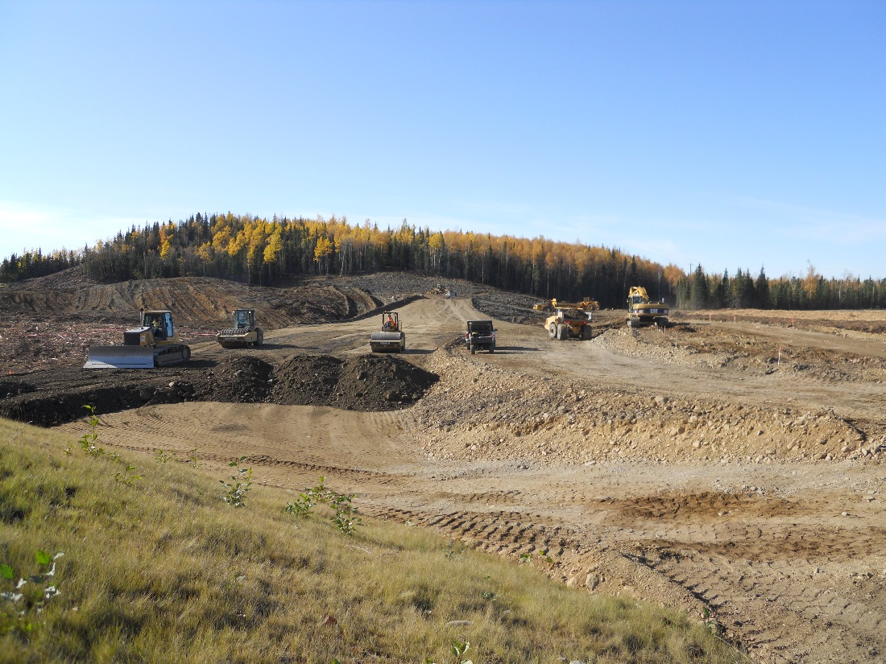
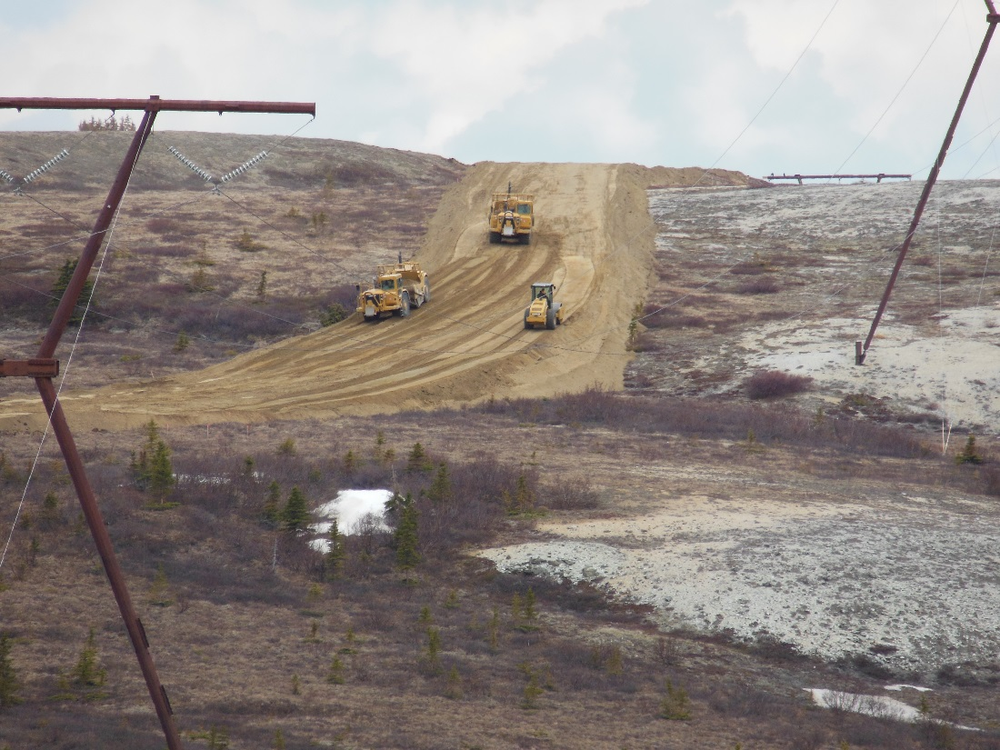
Specification Lesson 3: Means and Methods
Bring on the innovation
Can the same goal be achieved different ways?
Alternative Procurement options?

Slide 11
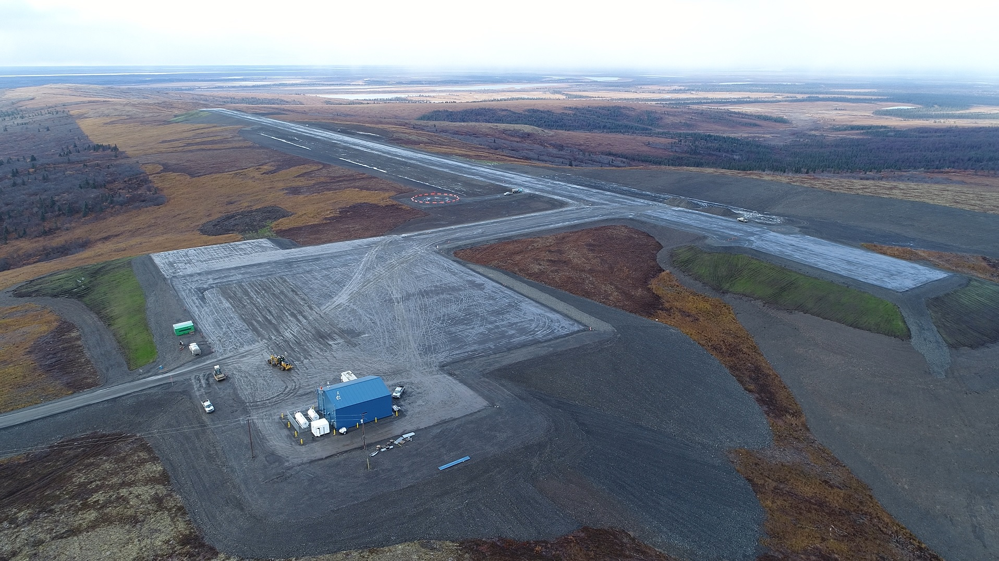
Questions?

